Slide 1
Data Analysis To Fuel Your Business’s Growth

Slide 2
About Me
Moved here in 2006 after graduating from New York University
Love exploring new cultures - been to over 30 countries with my husband

Slide 3
Experience in Business
Left job as an art director to start Stickboy Creative in 2007 during the housing crash
In addition to growing Stickboy, built and sold an online data company
Also a technology advisor to national and local businesses

Slide 4
If You Only Remember One Thing….
StickboyCreative.com/symposium
This Presentation
Links to the tools we’ll be covering today

Slide 5
Before we get started
Don’t you wish you could know more about how your business is running?
The data you need is everywhere and available
Businesses like yours can use these tools and techniques to see amazing growth

Slide 6
Visualizing Business Data Analysis

Slide 7
Online Customer Behavior

Slide 8
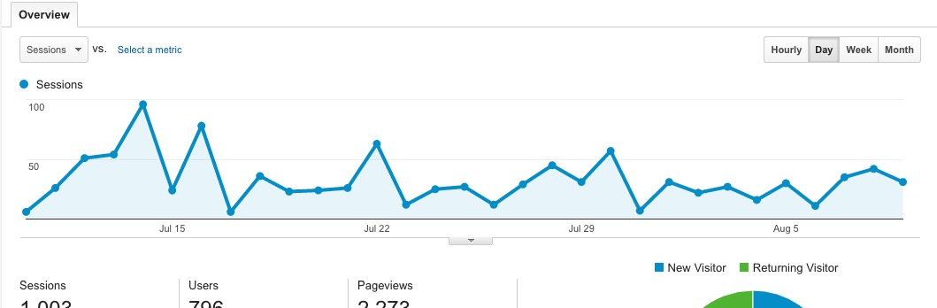
Where are your customers going?
Analytics and visitor tracking
Google Analytics

Slide 9
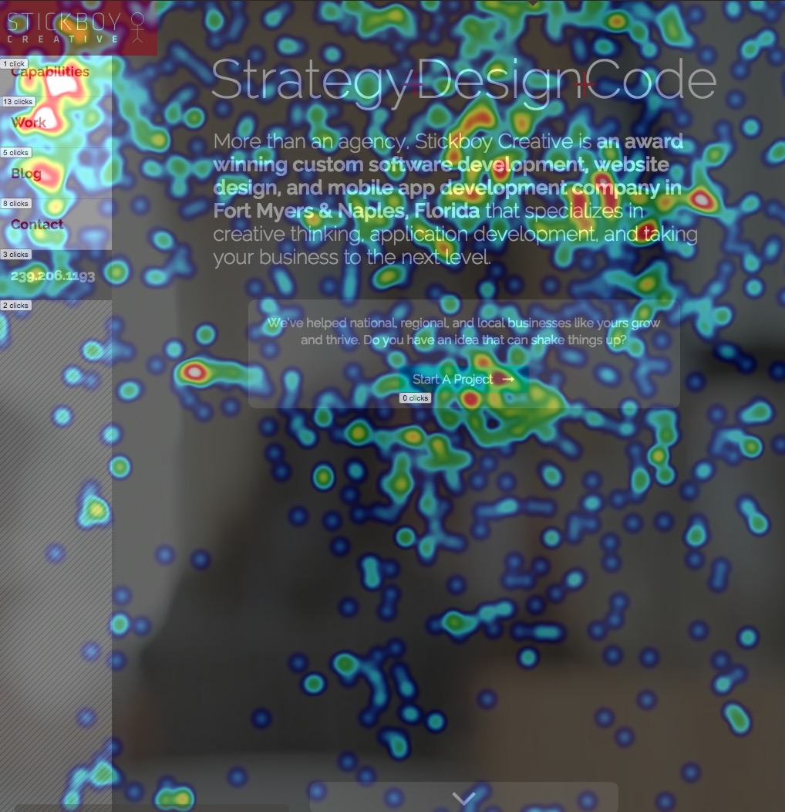
What are your customers doing?
Heat Mapping and behavior tracking
MouseFlow

Slide 10
What is your customer saying?
Review sites
Trustpilot, Google Reviews, Yelp, etc

Slide 11
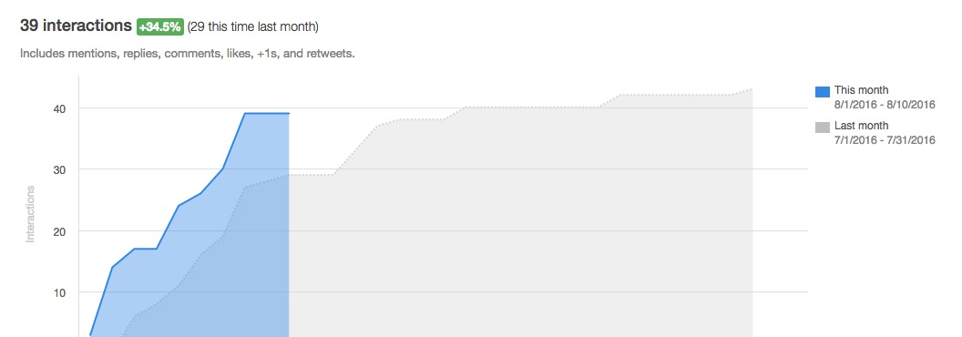
Are you where your customer is?
Automated Social Media Monitoring
Hootsuite, Hubspot, etc

Slide 12
Point of Sale Data

Slide 13
Inventory Data Analysis
Pizza Crust Option
3% or lower purchase rate, and it’s eliminated
Streamlines the business and cuts costs

Slide 14
Customer Data Analysis
Heatmap of all your customers
Where are they located?
How much do they spend?

Slide 15
Internal Processes

Slide 16
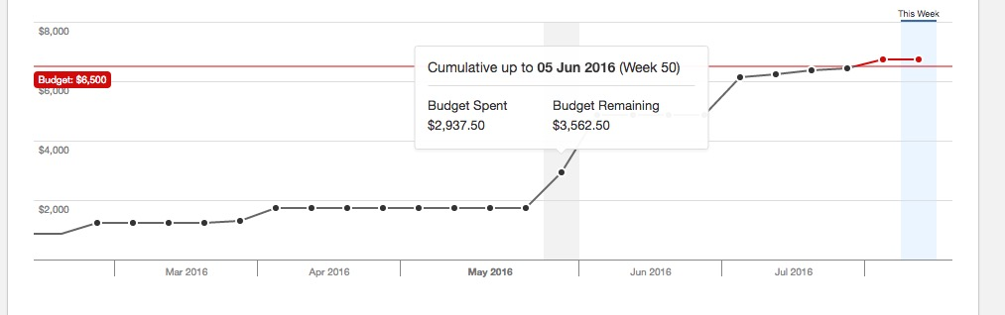
Employee Efficiency
How are your employee resources being used?
Harvest

Slide 17
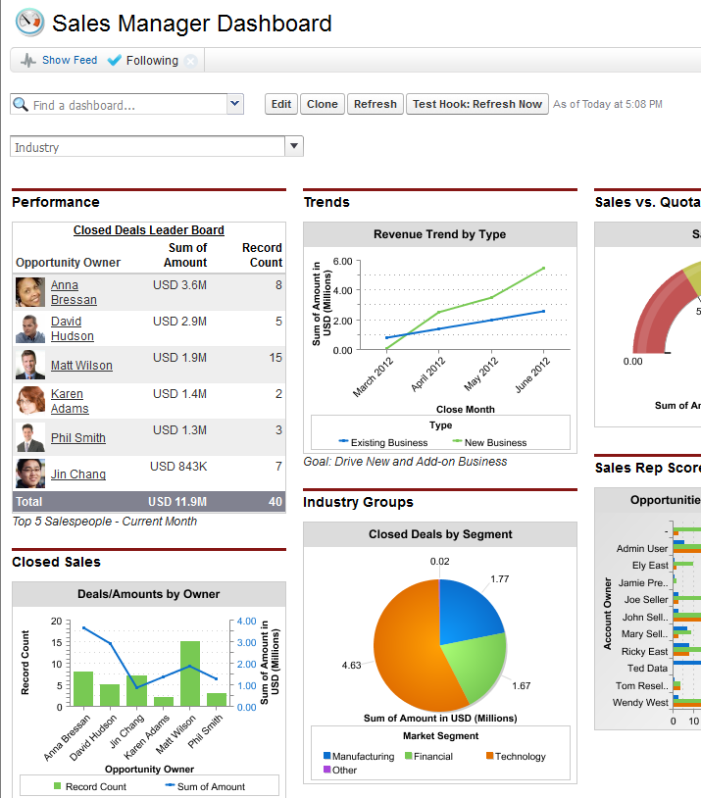
Customer Intelligence
By having customer data, you’re able to make informed decisions on how best to serve them
Salesforce

Slide 18
Examples

Slide 19
Customer Behavior
Analyzed customer heatmap behavior
Made changes to the website to address customer needs
Saw immediate increase in conversions

Slide 20
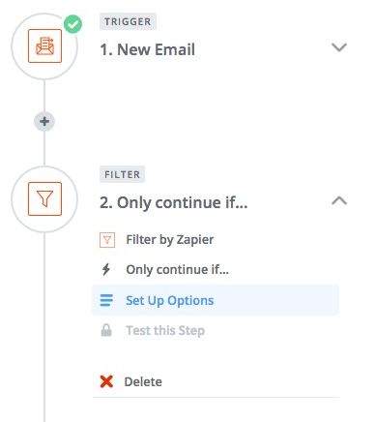
Intelligent Remarketing
Digested customer data for reviews
Automated follow ups to best-performing customers
Positive reviews increased dramatically

Slide 21
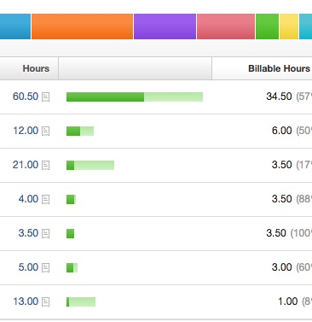
Process Automation
Looked at employee hours data across multiple departments
Saw which tasks were taking the most time in the company
Automated tasks, increasing employee efficiency and customer satisfaction

Slide 22
Make sure you remember:
StickboyCreative.com/symposium
This Presentation
Links to the tools we covered today

Slide 23
To Sum Up…
Business data analysis can be the key that unlocks massive growth in your company.
It can also help you connect with your customers and provide them with better service
Understanding the data can help you steer your business in the right direction.

Slide 24
Thanks!

